Slide 1
Deep learning basics part 2

Slide 2
Most popular CNN architectures
Lenet-5
AlexNet, ZFNet
VGG
GoogLeNet
ResNet

Slide 3
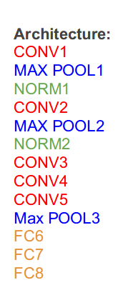
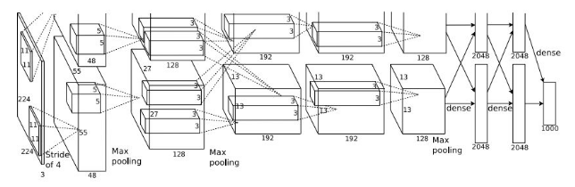
AlexNet

Slide 4
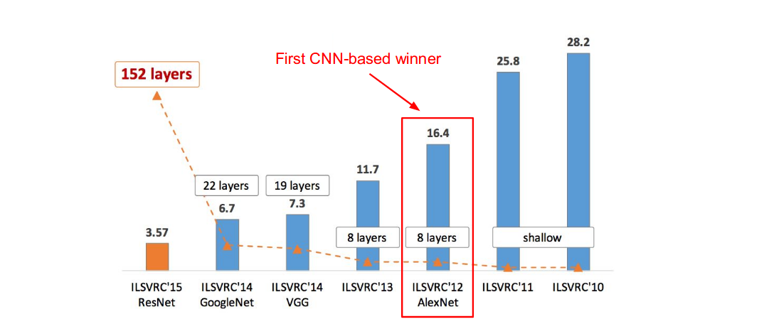
AlexNet

Slide 5
ZFNet
Improved hyperparameters over AlexNet
Winner of ILSVRC’13: ImageNet top 5 error: 16.4% -> 11.7%
CONV1: change from (11x11 stride 4) to (7x7 stride 2)
CONV3,4,5: instead of 384, 384, 256 filters use 512, 1024, 512

Slide 6
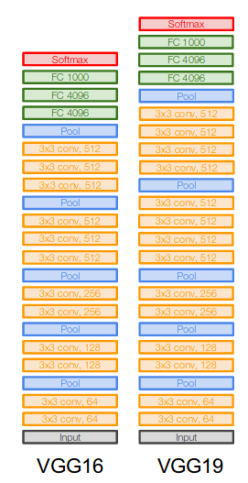
VGGNet
Smaller filters, deeper network
Only 3x3 CONV stride 1, pad 1and 2x2 MAX POOL stride 2
Stack of three 3x3 conv (stride 1) layers has same effective receptive field as one 7x7 conv layer (but deeper, more nonlinearities and less parameters)
7.3% top 5 error in ILSVRC’14

Slide 7
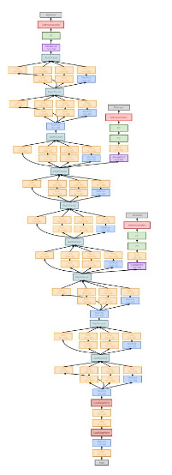
GoogLeNet
22 layers
Efficient “Inception” module
No FC/Dense layers
Only 5 million parameters - 12x less than AlexNet
6.7% top 5 error in ILSVRC’14

Slide 8
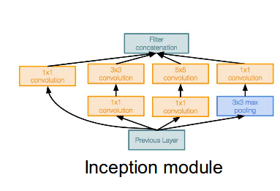
Inception module
Design a good local network topology (network within a network) and then stack these modules on top of each other

Slide 9
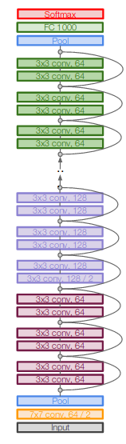
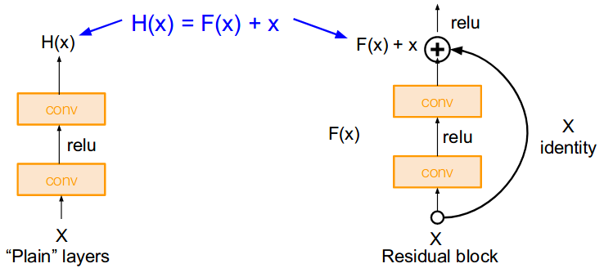
ResNet
152 layers
Use network layers to fit a residual mapping instead of directly trying to fit a desired underlying mapping

Slide 10
Recurrent NN
Modelling sequences of data
Used for:
Speech recognition
Machine translation
Image recognition

Slide 11
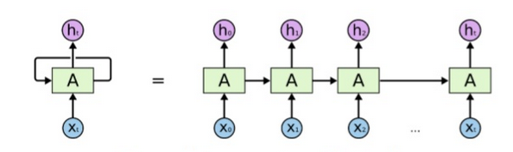
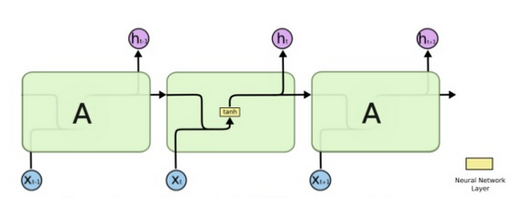
Recurrent NN

Slide 12
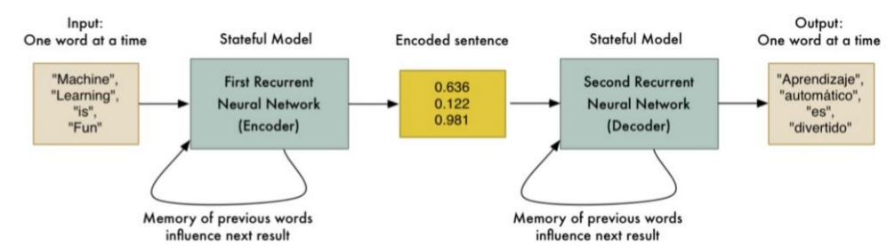
Recurrent NN
Machine translation

Slide 13
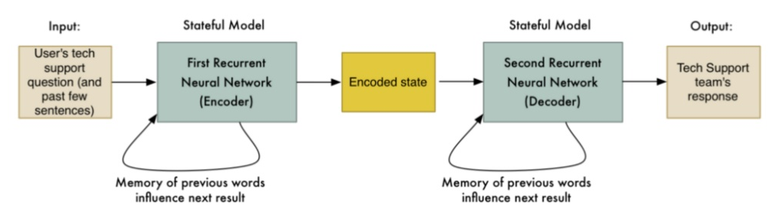
Recurrent NN
Conversation Bot

Slide 14
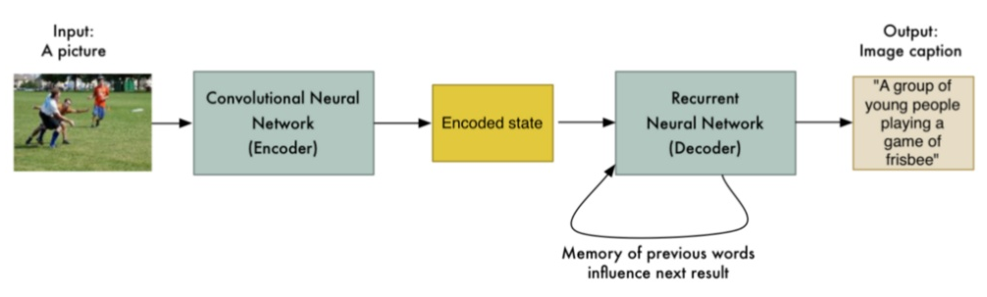
Recurrent NN
Image description

Slide 15
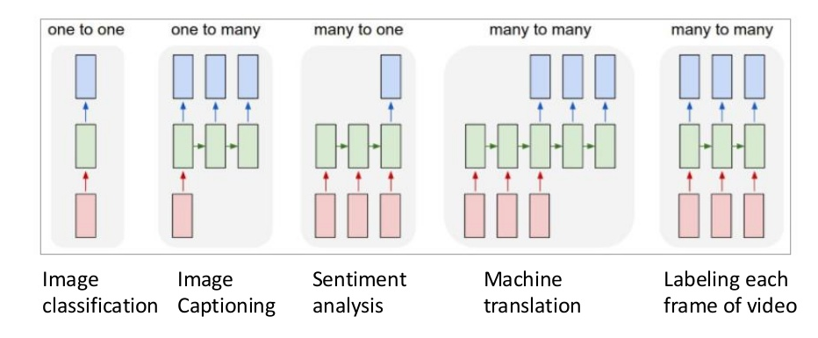
Recurrent NN

Slide 16
Recurrent NN
Types or RNN cells:
Simple
GRU
LSTM

Slide 17
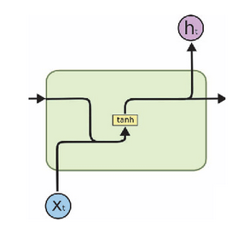
Recurrent NN – Simple Cell
Here there is simple multiplication of Input (xt) and Previous Output (ht-1). Passed through Tanh activation function. No Gates present.

Slide 18
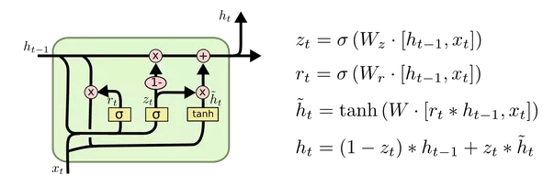
Recurrent NN – GRU cell
Here a Update gate is introduced, to decide whether to pass Previous O/P (ht-1)to next Cell (as ht) or not. Forget gate is nothing but additional Mathematical Operations with a new set of Weights (Wt).

Slide 19
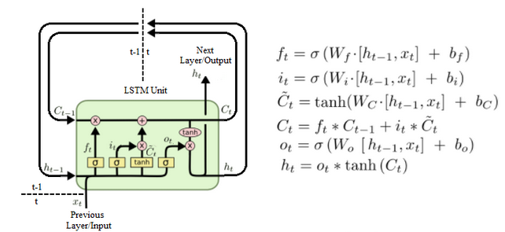
Recurrent NN – LSTM cell
Here 2 more Gates are introduced (Forget and Output) in addition to Update gate of GRU. And again as above, these are additional Mathematical Operations on same inputs (xt and ht-1). So overall, LSTM has introduced 2 Math operations having 2 new sets of Weights.

Slide 20
DEMO – Char-RNN

